Slide 1
Nonrefundable & Refundable Credits Overview Foreign Tax Credit
Pub 4012 Tab G
Pub 17 Chapter 37
(Federal 1040-Line 48)
Notes:
1

Slide 2
Definitions
Credit – a dollar-for-dollar reduction of the tax liability
Nonrefundable Credits – can reduce the tax liability to zero, but does not provide a refund of excess credit
Appear in Nonrefundable Credits section of 1040
Refundable Credits – can reduce the tax liability to zero & provide a refund of excess credit
Appear in Payments Section of 1040
Notes:
Recap: Credits are different than Adjustments.
Credits are dollar for dollar reduction of tax liability
Adjustments are dollar for dollar reduction to Income.
Nonrefundable credits are applied against the tax liability in the order that they are listed on 1040
2

Slide 3
Nonrefundable Credits in Scope
Foreign tax credit
Child care credit
Nonrefundable part of Education credit
Retirement savings credit
Child tax credit
Residential energy credit (expired for 2017)
Earned income credit
Credit for the elderly or disabled
Other nonrefundable credits are Out of Scope
Adoption credit, DC first-time homebuyer credit, mortgage interest credit, alternative motor vehicle credit, qualified electric motor vehicle credit, small employer health insurance premiums, credit for Federal tax paid on fuels, credit for increasing research activities from pass-through entities
Notes:
3

Slide 4
Nonrefundable Credit Foreign Tax Credit – 1040 Line 48
Pub 4012 Tab G
Reported to taxpayer on 1099 INT or 1099 DIV (usually on brokerage statement)
Only In Scope if < $300 ($600 MFJ)
Enter Foreign Tax Withheld from Box 6 in Federal section \ Income \ Enter Myself \ Interest & Dividends (1099-INT, 1099-DIV) \ Interest Income, Form 1099-INT
TaxSlayer will automatically create Foreign Tax Credit on 1040 Line 48
Notes:
4

Slide 5
TS - 1099-DIV Dividends Federal section \ Income \ Enter Myself \ Interest & Dividends (1099-INT, 1099-DIV) \ Dividend Income, Form 1099-DIV, Box 1
Foreign tax withheld
Notes:
5

Slide 6
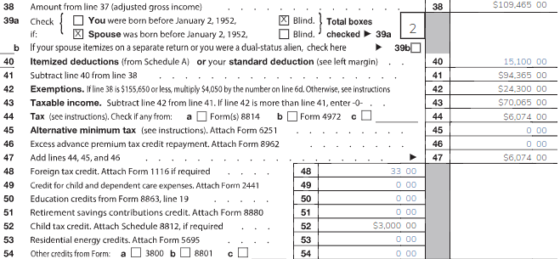
TS – 1040 Line 48 – Foreign Tax Credit
Notes:
6

